Slide 1
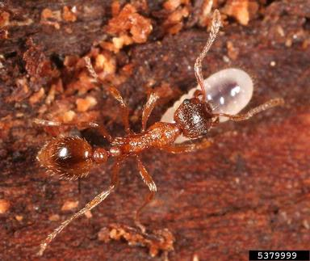
Tools for Defending Your Community from Invasive Species Rachelle McElroy, Executive Director Coastal ISC AVICC Conference, April 9 2017
Notes:
Summary
Local governments are applying tools (e.g. Legislative, tech-savvy, educational and collaborative) and working with the Coastal ISC and Broombusters to take an active role in reducing the negative impact of invasive species in their communities. Emphasized are the CowVRD (Giant Hogweed Bylaw), RDN and Comox VRD (Knot on My Property Program), PRRD (Burn Boss and more!), MWRD (Knotweed Partnership) and Campbell River (Invasive Plant Free Seedy Sunday).
Highlighted is the 10-year partnership between the Town of Qualicum Beach and volunteers of Broombusters, which has made the town almost Scotch broom free! They will tell you how your community can do it too.

Slide 2
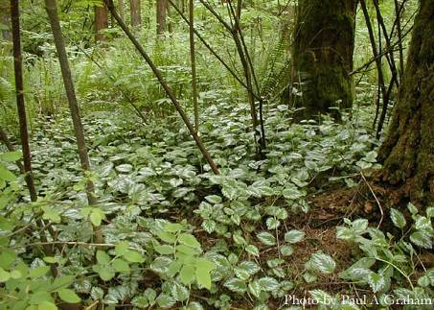
Invasive Species Review
Defn.: Alien Invasive Species (AIS)
Causing harm
Non-native, no natural predators, establish quickly, competitive
Negative impacts
Public health
Environment
Economic
Paul A. Graham
Lamiastrum galeobdolon
(Yellow archangel)
Notes:
2
What is an invasive plant?
Non-native
Alien - refers to originating outside of BC or Canada (depending on who is using the term)
Non-native/exotic/ introduced plant species (originating from a different province in Canada or from a different country or continent)
MoFR uses it to refer to out-of-province
Federal Government uses it to refer to out-of-country
No natural predator present to regulate introduced populations
Highly aggressive, adaptive characteristics
Establish quickly and easily on new sites
Negative impacts to humans, animals, ecosystems and natural resource industries
Often difficult to control:
Often perennial, high seed production, capable of spreading by seed (once or twice per year), vegetative re-growth
Effective means of dispersal (burrs/wings/seed pod projection, etc)
Long seed life (dormancy in soil of up to 70 yrs with some species!)
Sometimes release toxins into soil that prevent the growth of other plants; release toxins through stems/leaves/berries that are toxic to humans/animals if ingested or touched
What is a noxious weed?
a plant designated as noxious by the BC Ministry of Agriculture and Land’s Weed Act
What is a weed?
General term used to refer to any plant a person may find undesirable
May refer to the above species but may not

Slide 3
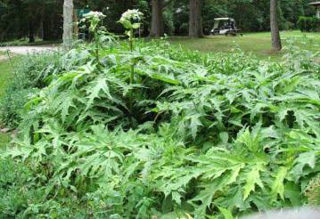
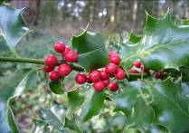
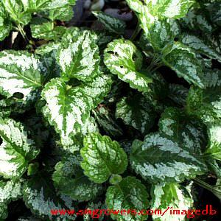
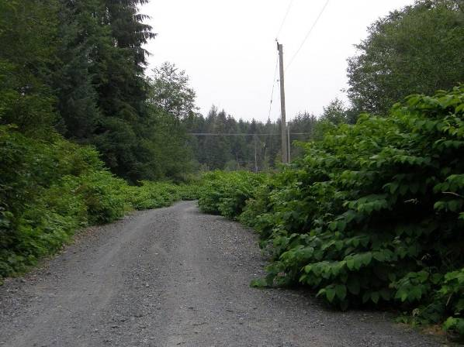
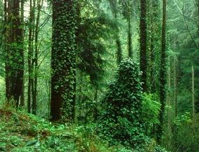
TOP 6 REASONS for Local Government Involvement in Cooperative Management of Invasive Alien Species

Slide 4
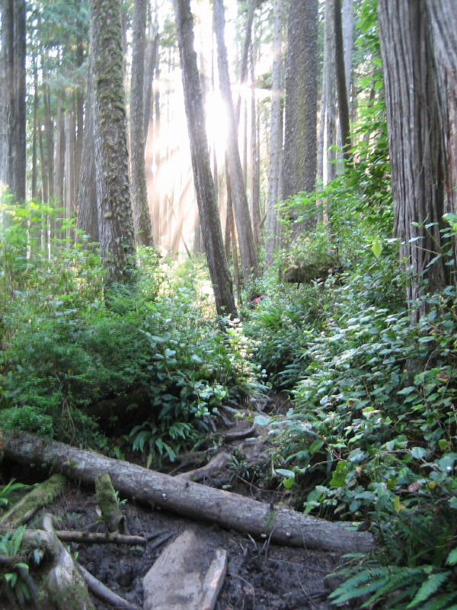
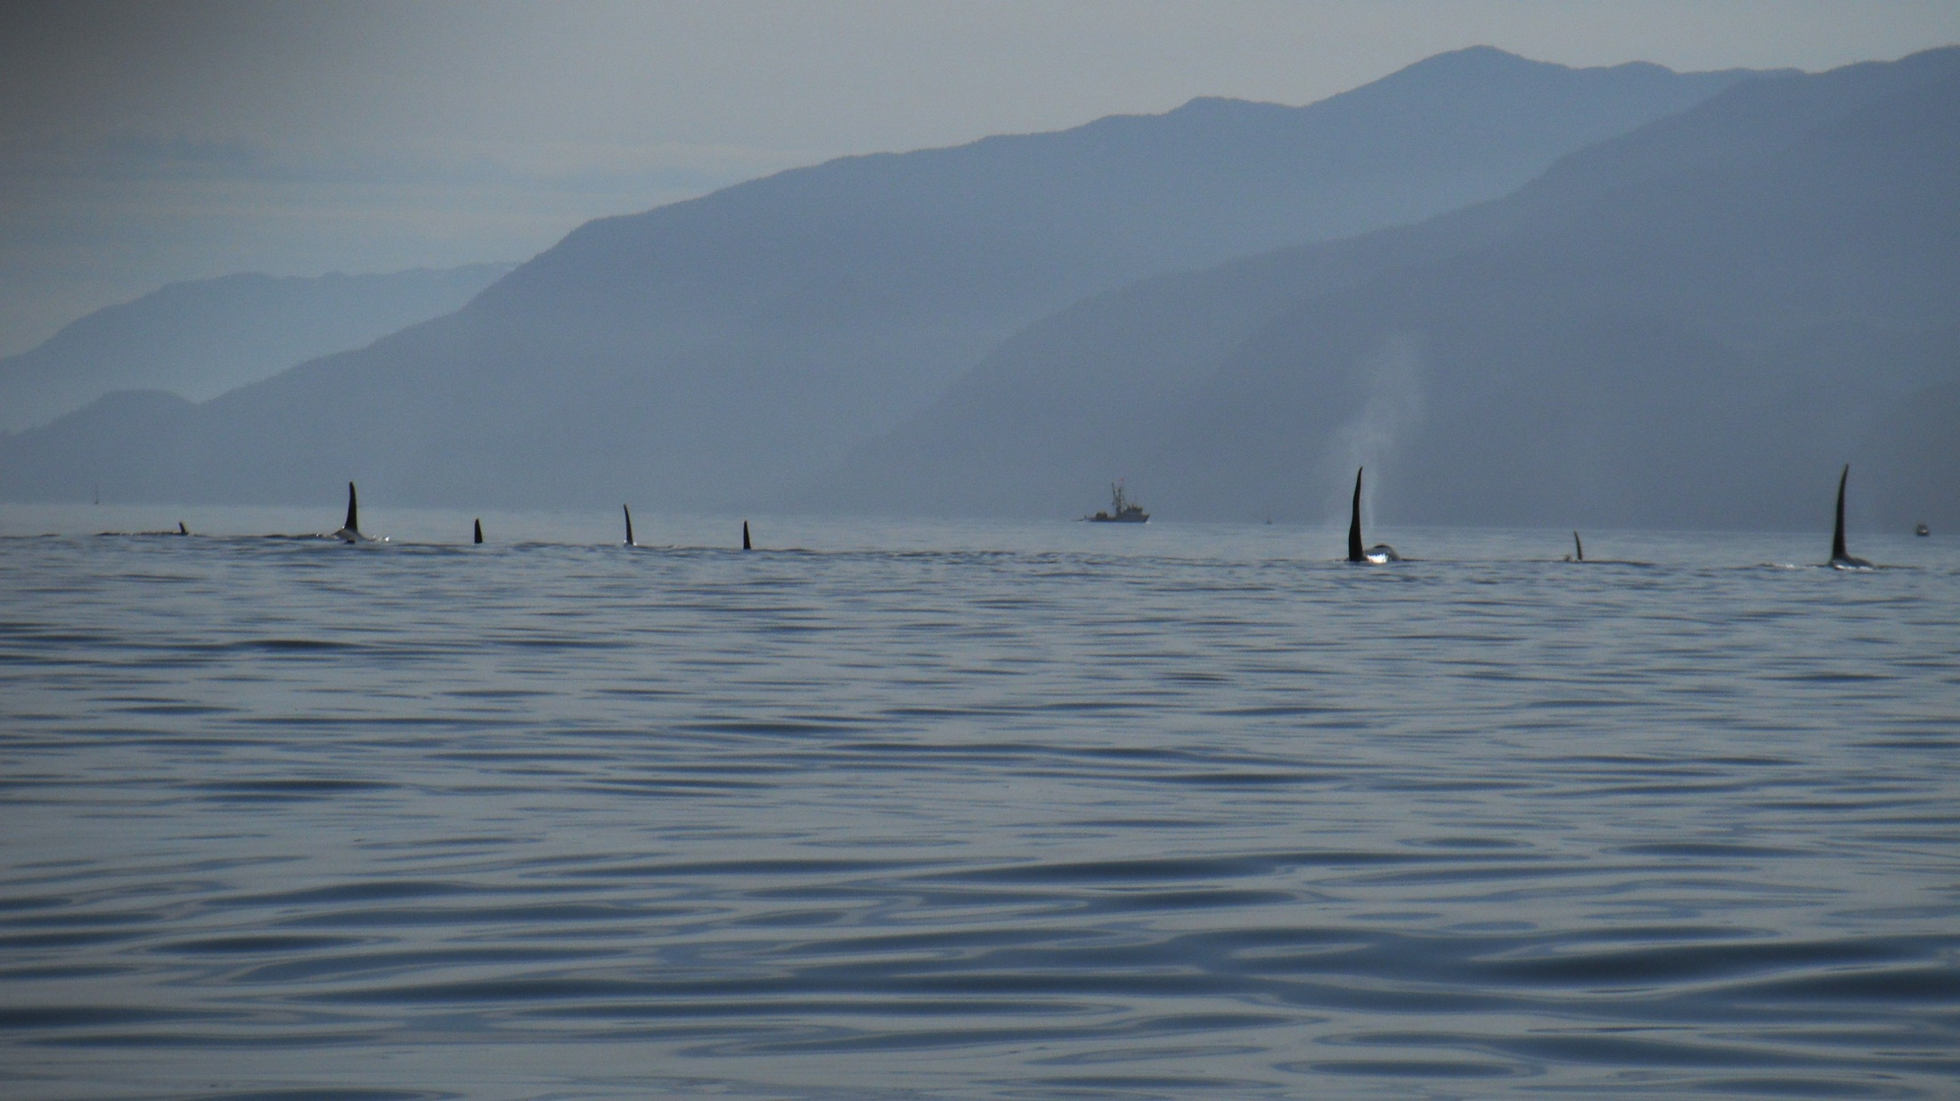
Biodiversity
Invasive species are the second largest threat to biodiversity on the planet (Conservation Union, 1998)
Notes:
6 – Biodiversity
In BC it is estimated that 25% of our endangered species, 31% of our threatened species, and 16% of our species of special concern are negatively impacted by invasive alien species (Voller and McNay 2007)

Slide 5
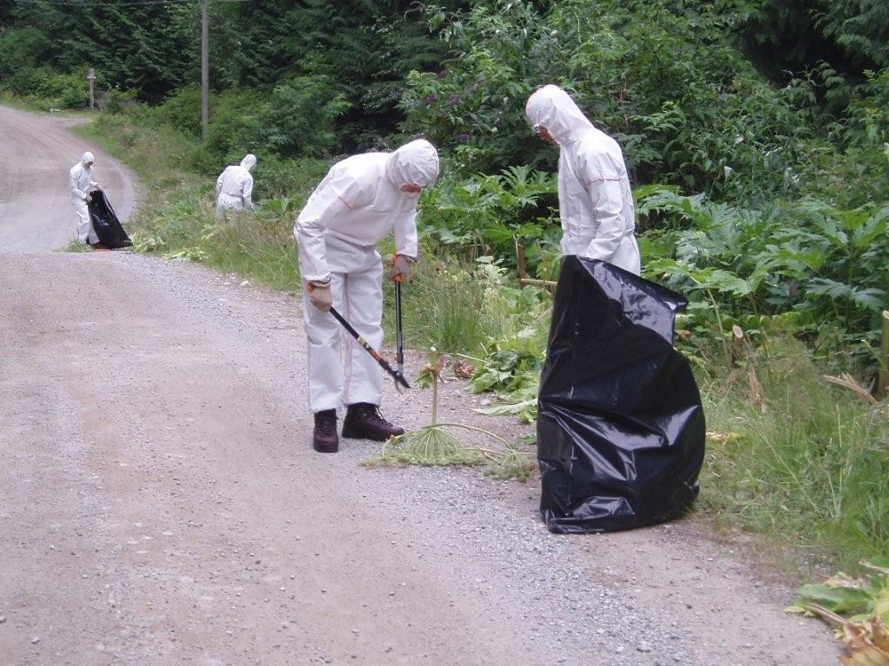
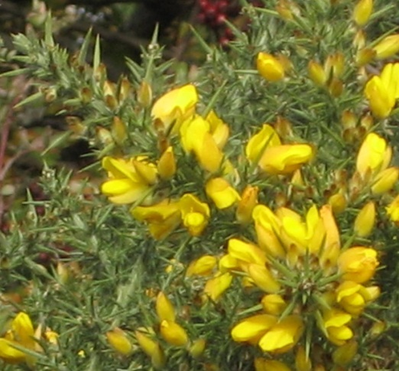
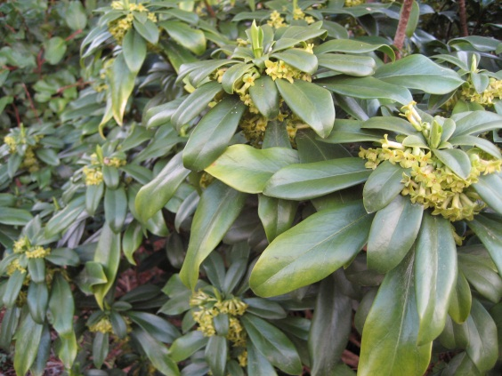
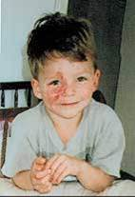
Human Health and Safety
Toxic sap (burns)
Allergen (respiratory)
Poisonous berries/plants (illness/death)
Fire Hazard
Notes:
5
3 – Human Health and Safety
Invasive plants directly affect human health and safety in many ways.
Giant Hogweed (Toxic sap) Blisters and longterm burns
Spurge laurel berries are poisonous.
Scotch Broom (allergens)
Scotch Broom (Fire Hazard) Fire Hazard
Scotch broom has a high oil content and parts of the bush die off naturally on mature plants, so there is always dead wood, even on “healthy” plants.
ALSO..IP affect rights-of-way and transportation corridors when rapidly establishing IP decrease access to equipment and structures,

Slide 6
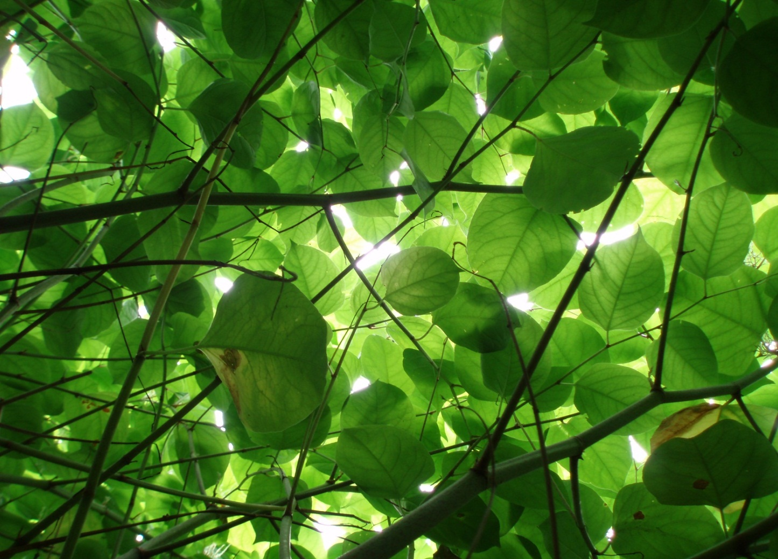
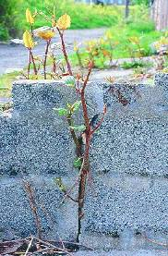
Property Value
Severe invasive plant infestations can depress property value
Increase maintenance costs to public parks
Impact First Nations traditional foods/fish/plants and archeology sites
Giant Knotweed (Fallopia sachalenensis)
Notes:
1 – Depress property value
Especially if you are a farmer, located on the waterfront or have a concrete foundation
Increased maintenance costs to public parks and private property, devaluing real estate. For example, due to the explosion of leafy spurge (Euphorbia esula), Manitoba has experienced a $30 million reduction in land values (Source: Invasive Alien Plants in Canada Summary Report by the Canadian Food Inspection Agency (CFIA).

Slide 7
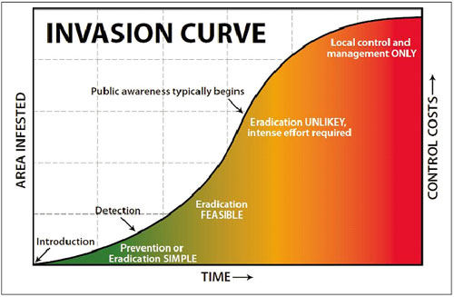
Economic Impacts
Prevention + Early Detection = Cost Effective
Notes:
5 – Economic Impacts
COST OF DOING NOTHING
EDRR – Provincial Approach
The biological invasion curve shows that detection and prevention make the most sense from monetary, environmental and effectiveness perspectives.
EDRR:
WHY: Once a new species establishes in the province and begins to disperse, the cost of control escalates rapidly and the potential for eradication diminishes.
Early detection of newly arrived invasive species, followed by a well-coordinated rapid response, will increase the likelihood of eradication or containment of new invasions. Early Detection Rapid Response (EDRR) has proven to be the most cost-effective means of controlling the expansion of invasive plants in North America.
WHAT: BC EDRR Plan is an action, communication and decision-making plan to prevent the establishment of new invasive plants into British Columbia.
HOW: six steps to the BC EDRR plan: Early Detection, Identification, Alert Screening, Risk Assessment, Response Planning, and Rapid Response (Figure 1). Each step is comprised of specific step-by-step actions, decisions, communications and associated responsibilities. Implementation of this plan will increase the likelihood that new incursions will be discovered, assessed and eradicated before they become widely established in British Columbia.
OUR APPROACH AND THE REASON Coastal ISC FORMED!

Slide 8
Economic Impacts of Invasion
Species | Annual Damages
 | (Can $ Millions)
 | 2008 | 2020
Eurasian Watermilfoil | 1 | 5
Scotch Broom | 3 | 8
Cheatgrass | 10 | 15
Diffuse Knapweed | 18 | 23
Purple Loosestrife | 20 | 28
Hawkweed | 13 | 60
Total | 65 | 139
 | Total area invaded (ha)
Dalmatian Toadflax | 9250 | 123400
Notes:
8
5 – Economic Impacts
COST OF DOING NOTHING
Eurasian Watermilfoil, damages increased by 5 times in 12 years, from 1 million to 5 million
Hawkweed, went from 13 million to 60 million in damages in 12 years
Impact on the environment and esthetics, look at Dalmatian Toadflax that went from 9,250 Ha – 123, 400 Ha in 12 years. Grew by 13 times in 12 years, average over 9 thousand hectares a year
Without efforts to contain their spread, invasive plants will generally increase their distribution area on average of 14% annually = populations double every 5 years!
EDRR – Provincial Approach

Slide 9
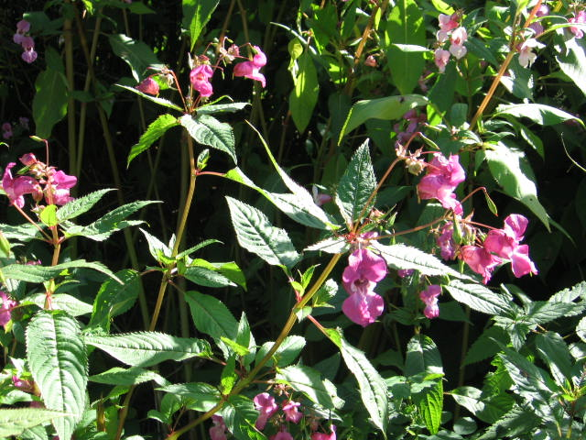
Compliance with Regulation
BC Legislation for Invasive Plant Management
BC Weed Control Act
Municipal Legislation
Community Charter: Weed Bylaws
Policeman’s Helmet (impatiens glandulifera)
Notes:
9 – Compliance with Regulation
BC Legislation for Invasive Plant Management (CROWN LAND)
BC Weed Control Act
Integrated Pest Management Act
Forest and Range Practices Act
Municipal Legislation
Community Charter (gives power to give bylaws): Weed Bylaws

Slide 10
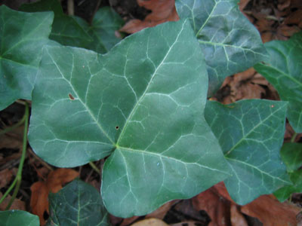
Legislation of Invasive Plants in BC
Federal Legislation
Canada Food Inspection Agency
Plant Protection Act
Seeds Act
Provincial Legislation
Ministry of Forests and Range
Forests and Range Practices Act (FRPA)
Forest Investment Account (FIA) Standards
Ministry of Agriculture and Lands
Weed Control Act
Ministry of Community Services
Community Charter
Local Government Act
Dike Maintenance Act
Ministry of Energy, Mines and Petroleum Resources
Pipeline Act
Ministry of Environment
Integrated Pest Management Act (IPMA)
Ministry of Transportation
Transportation Act
English ivy
(Hedera helix)
Notes:
The main legislation pertaining to invasive plants is currently held by the provincial government. The ministries and the links to their legislation are listed below.
Also included is the federal legislation governing the approval and importation of biocontrol agents into Canada.
For a thorough listing and explanation of legislation pertaining to invasive plants in BC, please see the Invasive Plant Council of BC's report A Legislative Guidebook to Invasive Plant Management in BC.
Multiple agencies and governments controlling invasive plants and adjoining land parcels.
Often unclear to land managers which legislation is in effect and how they are to comply with that effective legislation.

Slide 11
2011 Update to Weed Control Act
Section 2 of the Weed Control Act states “In accordance with the regulations, an occupier must control noxious weeds growing or located on land and premises, and on any other property located on land and premises, occupied by that person.”

Slide 12
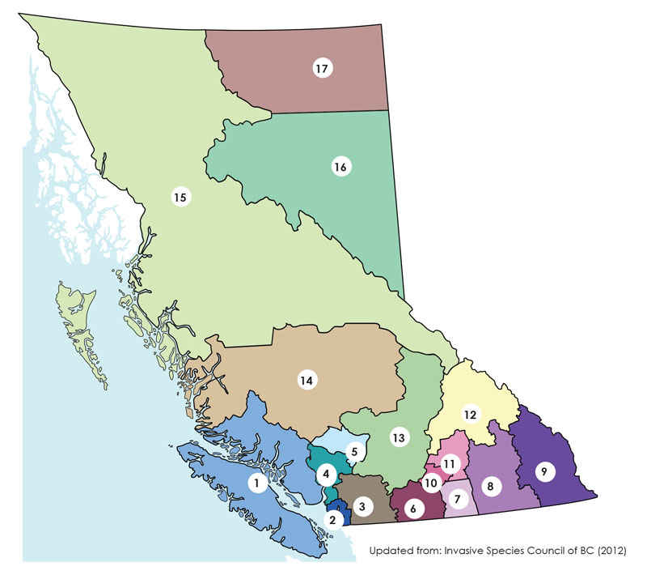
Goal of the Coastal ISC
Providing more efficient and effective invasive species management in the Coastal ISC service area through regional collaboration, information-sharing, planning and programs
12

Slide 13
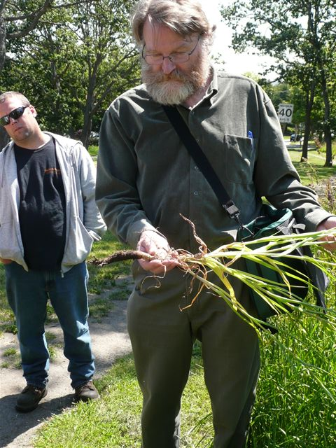
Key Benefits
Effective management in the Region
Avoid duplication of efforts
Better use of resources
Cooperative: more funding
Enable smaller jurisdictions and land managers
13

Slide 14
Coastal ISC Priorities
Early Detection Rapid Response (EDRR) provincial approach
Regional Education and Outreach
Disposal: issues & opportunities
Inventories, Control & Mapping
Research & Trials
Collaboration
14
Blessed Milk Thistle

Slide 15
Steps to Control Invasive Species
Public Outreach/Education
Prevention
GOAL: Efficient Cooperative Management of Invasive Species
Landowner/Manager Incentives
Early Detection, Rapid Response
Inventory and Data Management
Prioritize/Plan
Treatment, Disposal, Monitoring and Restoration
Regulations
Reference: ISCBC 2014, Invasive Species Toolkit for Local Government

Slide 16
Steps to Control Invasive Species
Public Outreach/Education
GOAL: Efficient Cooperative management of Invasive Species
Comox Valley
Alberni-Clayoquot
Strathcona
Powell River
Cowichan Valley
Nanaimo
Mount Waddington
Prevention
Landowner/Manager Incentives
Early Detection, Rapid Response
Inventory and Data Management
Prioritize/Plan
Treatment, Disposal, Monitoring and Restoration
Regulations
Total: 111 land managers engaged
Reference: ISCBC 2014, Invasive Species Toolkit for Local Government
Notes:
Seven out of nine Regional Districts in the Coastal ISC service area participated
Meeting objective:
Share updates on invasive plant management activities of each land manager;
Revisit prioritization of invasive plant species and activities including inventory, treatment and;
Discuss options for prioritizing sites within the regional district.

Slide 17
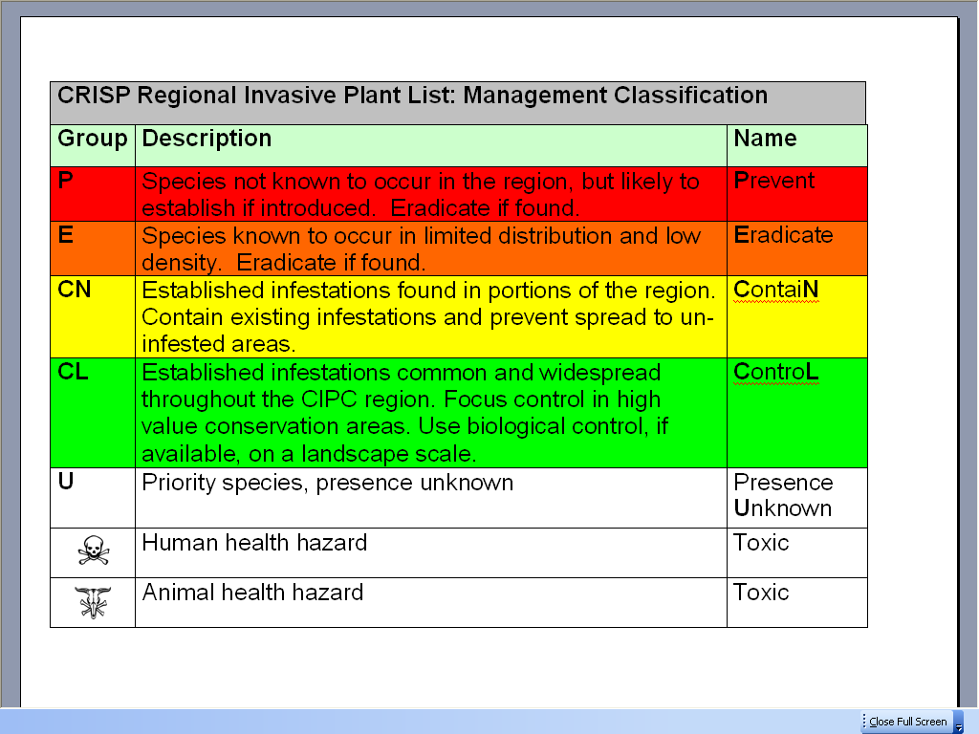
Regional District Priorities
17

Slide 18
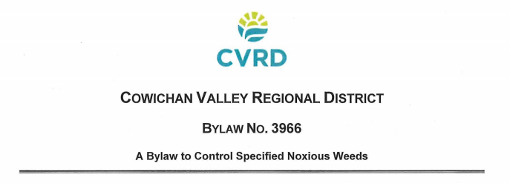
SUCCESS STORIES
Public Outreach/Education
Prevention
Landowner/Manager Incentives
Early Detection, Rapid Response
Inventory and Data Management
Prioritize/Plan
Treatment, Disposal and Monitoring
Regulations

Slide 19
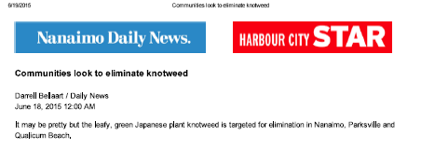
SUCCESS STORIES
Public Outreach/Education
Prevention
Landowner/Manager Incentives
Early Detection, Rapid Response
Inventory and Data Management
“Get your Knotweed and Giant Hogweed treated for FREE by a Invasive Species Professional”
Prioritize/Plan
Treatment, Disposal, Monitoring and Restoration
Regulations

Slide 21
SUCCESS STORIES
Public Outreach/Education
Prevention
Landowner/Manager Incentives
Early Detection, Rapid Response
Inventory and Data Management
Mount Waddington Regional District and partners (LoG, MoTI and First Nations): Knotweed control and job skills training (Min. Social Development)
Gas tax funding!
Prioritize/Plan
Treatment, Disposal, Monitoring and Restoration
Regulations

Slide 22
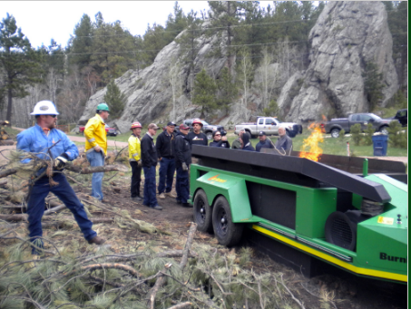
SUCCESS STORIES
Public Outreach/Education
Prevention
Landowner/Manager Incentives
Early Detection, Rapid Response
Inventory and Data Management
Prioritize/Plan
Treatment, Disposal, Monitoring and Restoration
Burnboss.com
Trailer mounted curtain burner
Partnership: PRRD, City of PR,
Tl’amine FN
Regulations

Slide 23
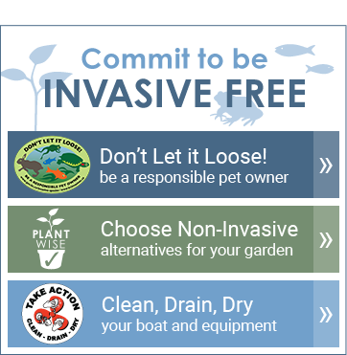
SUCCESS STORIES
Public Outreach/Education
Prevention
Landowner/Manager Incentives
Early Detection, Rapid Response
Inventory and Data Management
Prioritize/Plan
Treatment, Disposal, Monitoring and Restoration
Campbell River Seedy Sunday; Commit to being invasive plant free!
Regulations

Slide 24
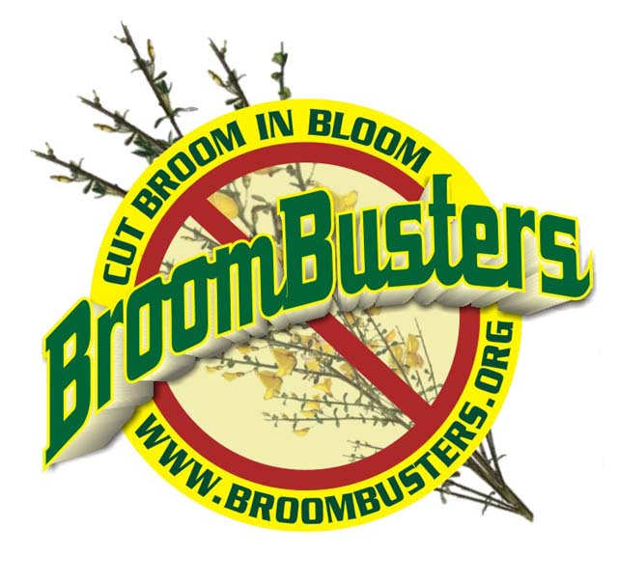
SUCCESS STORIES
Public Outreach/Education
Prevention
Landowner/Manager Incentives
Early Detection, Rapid Response
Inventory and Data Management
Prioritize/Plan
Joanne Sales, Broombusters and Neil Horner, Town of QB
Ten Year Partnership with Qualicum Beach!
Treatment, Disposal, Monitoring and Restoration
Regulations

Slide 25
Broombusters Invasive Plant Society

Slide 26
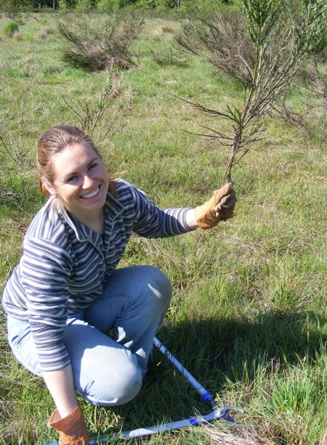
Parksville
“Vancouver Island has more Scotch Broom than Scotland!”
Moira Macleod a visitor from Scotland said:

Slide 27
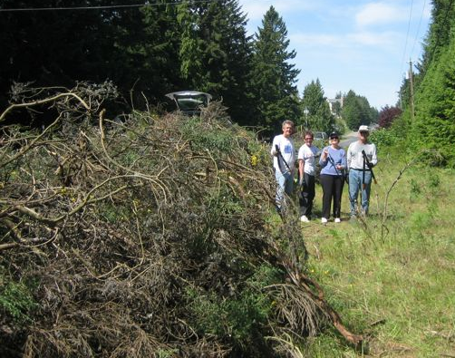
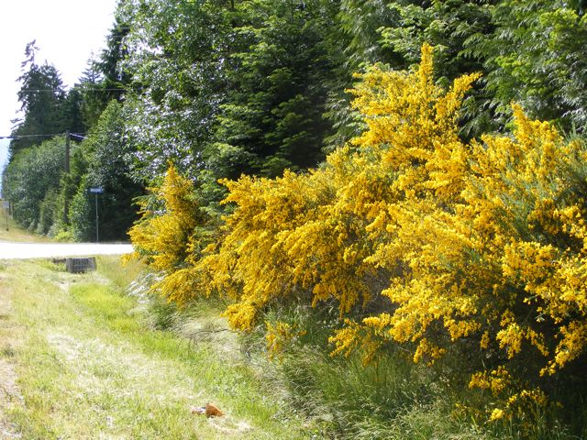
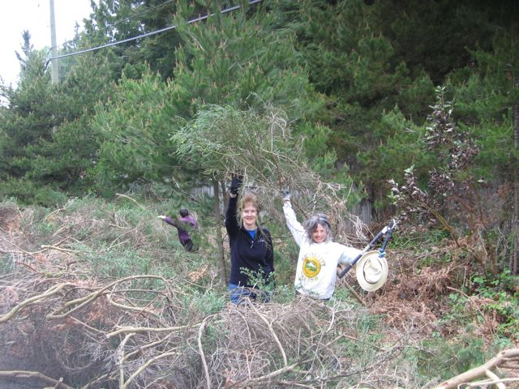
In 2006, Qualicum Beach had LOTS of broom.

Slide 28
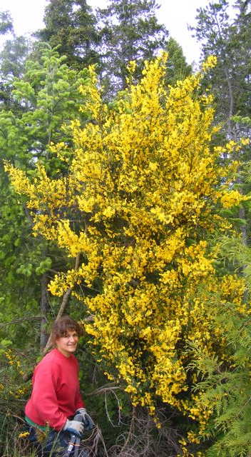
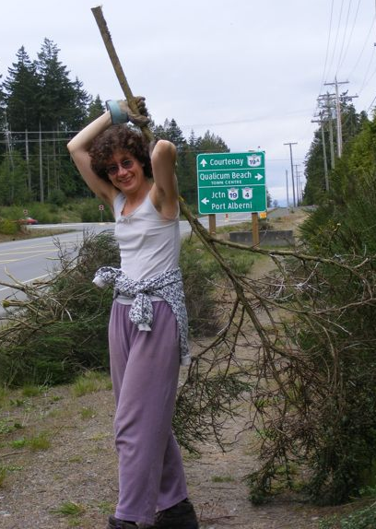
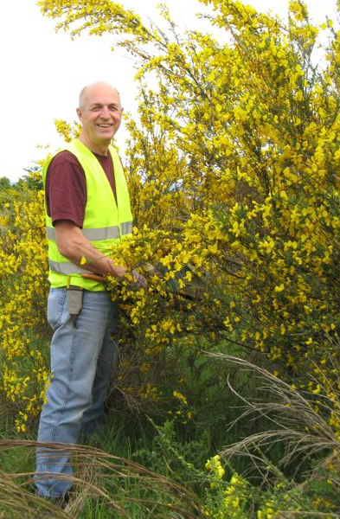
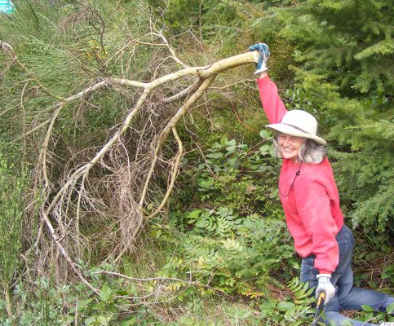
BIG BROOM

Slide 29
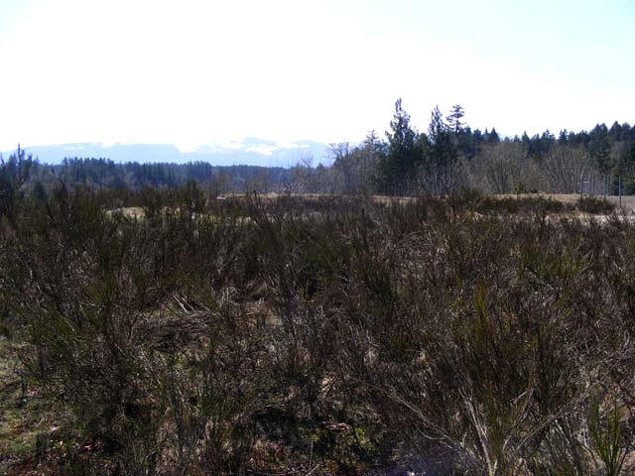
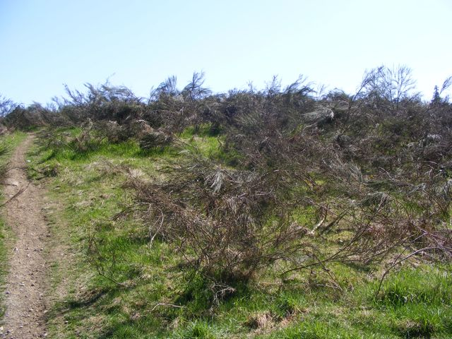
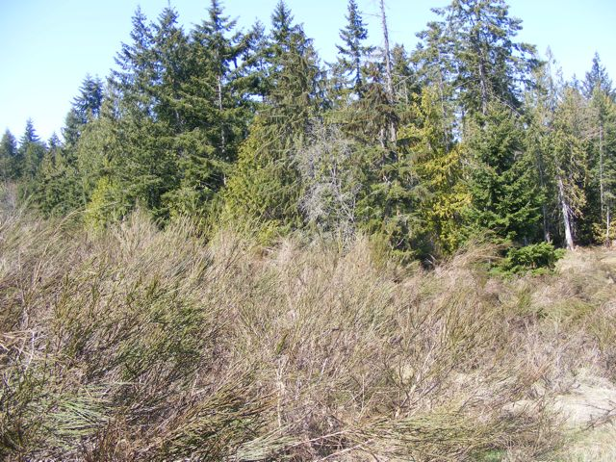
Qualicum Beach Airport
and old landfill 2006
Fire Danger!

Slide 30
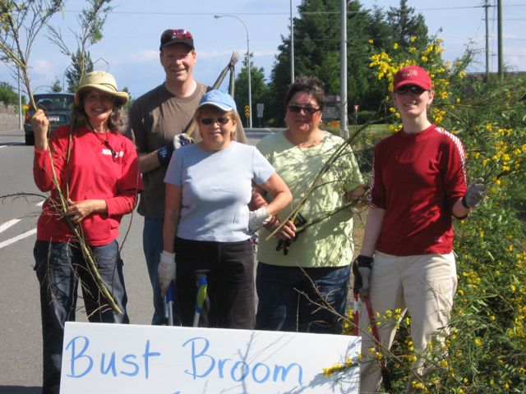
First Broombusters Qualicum Beach - 2006

Slide 31
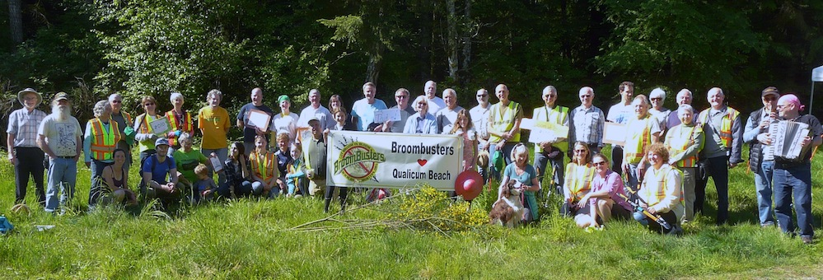
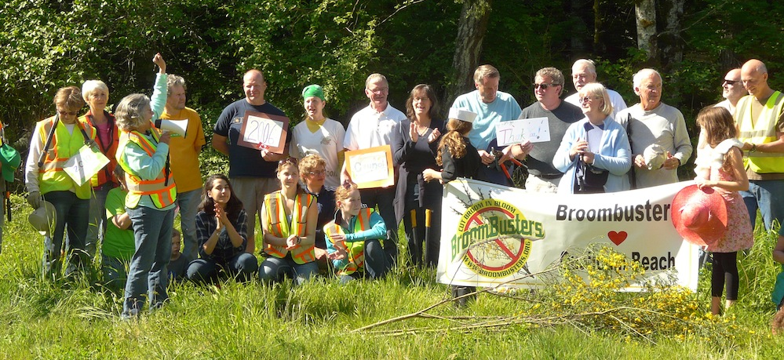
“Broomfest” May 7, 2016 10 years later
10 years later - Qualicum Beach is almost Broom free

Slide 32
What’s wrong with Scotch Broom?

Slide 33
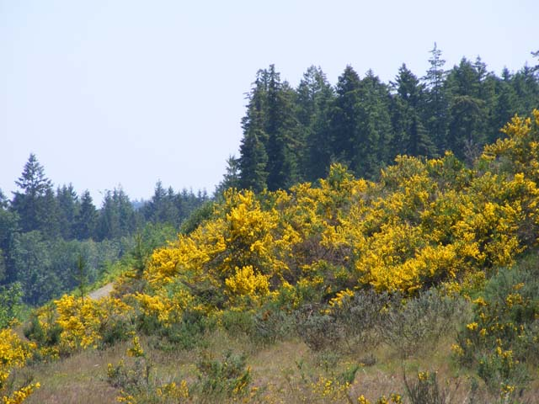
What’s Wrong with Scotch Broom?
Scotch broom is an ALIEN invasive plant that Spreads rapidly and densely Forms dense thickets
Crowds out native plants
Leads to dramatic loss of diversity
Slows and prevents forest re-growth Causes allergies Highly flammable Called the “Scourge of Pasture Land” Toxic to grazing animals and land Makes farmland useless.
Broom takes over anywhere in the sun.

Slide 34
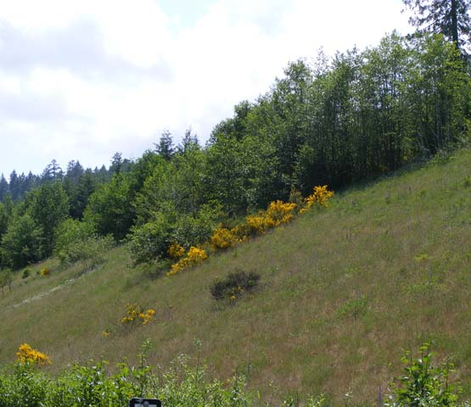
Broom Spreads Rapidly & Densely Crowds out Native Plants
These photos were taken during a dry spring. 75% of the branches were dry and dead.
Inland island Highway

Slide 35
Forests in Danger
Broom strangles young trees as they compete for sun, water and nutrients.
Oregon estimates that it loses over $47 million each year in lost timber sales because of Scotch Broom.
With climate change and invasive plants, it is becoming more difficult for our forests to grow back in balance & good health.

Slide 36
Forests & FARMS in Danger
The yellow broom field used to be a forest of fir. Broom grows faster than trees and also takes over pastures and farm fields.
Parksville Interchange #51

Slide 37
Fire Hazard !!
"Scotch Broom is a volatile flash fuel. The presence of Scotch broom will increase a wildfire’s fuel load and escalate the fire’s intensity, compromising fire situations and making them more difficult to fight."
Terry Peters Fire Chief Director of Emergency Services City of Powell River B.C.

Slide 38
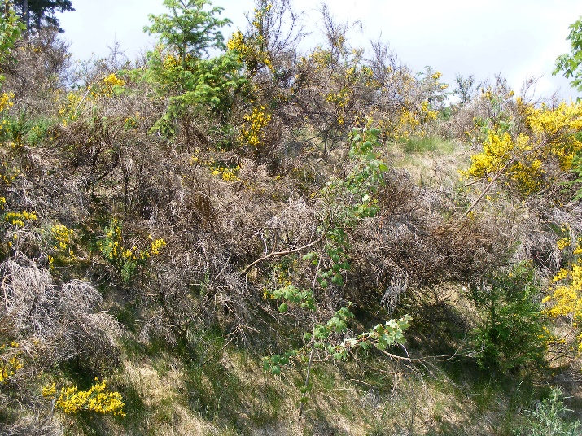
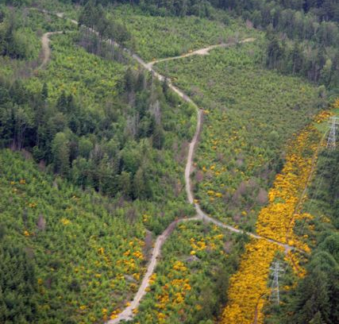
Fire Hazard !!
“Two invasive species cause fire behaviour and control concerns: broom and gorse.”
The Coastal Fire Service is saying wildfires are harder to predict and control when gorse and broom are present. We can’t say we didn’t know…
From www.bcwildfires.ca website. Coastal Fire Centre, 2015, of BC Govt, Ministry of Forests, Lands and Natural Resources

Slide 39
MYTHS about Scotch Broom
Myth 1: You can’t stop Scotch broom. FALSE!
Scotch broom produces up to 18,000 seeds per plant which can sprout for the next 20-40 years. BUT WE CAN STOP THE SPREAD Cut in Broom in Bloom www.broombuster.org for details
MYTH #2: Broom is naturalized. FALSE! Broom is just getting started! Broom covers whole mountains in Portugal, Spain, Australia, Brazil, Croatia, and New Zealand. We can’t let that happen here.

Slide 40
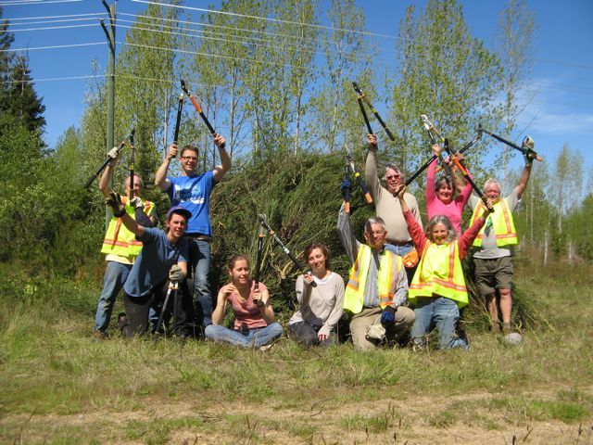

Slide 41
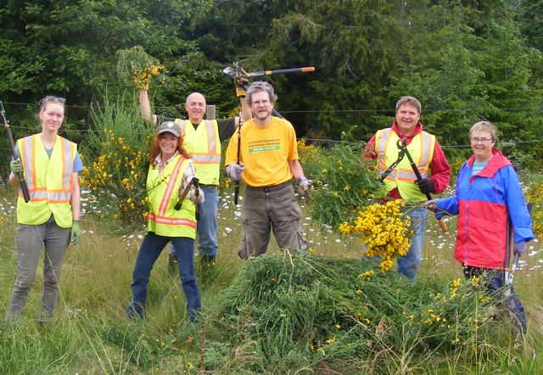

Slide 42
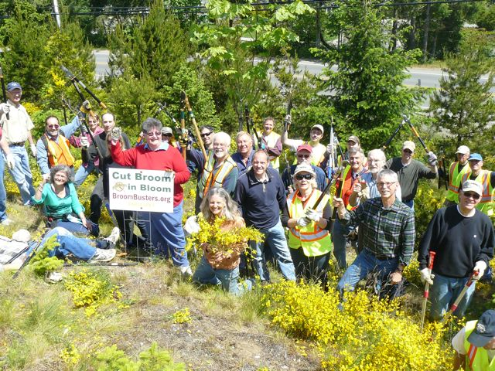

Slide 43
VIDEO

Slide 44
Broombusters Key Strategies: Empower the Community Think - CUT BROOM IN BLOOM With loppers, at ground level, in late April – May. Do not pull.
Just cut. Do not disturb the soil. No need to poison. Think - CONTAINMENT Go after advancing edge & new infestations first. Think – STOP THE SPREAD Think - COOPERATION Communities, cities, media, ministries all working together with one goal. CONTACT BROOMBUSTERS!

Slide 45
Some ideas for City Participation www.broombusters.org Consider BROOM REMOVAL Removing broom cut by volunteers on roads & in parks. Consider SIGNS Signs inform the public, make a statement & invite participation. Consider PUBLIC STATEMENTS Let the public know that the city wants to eradicate broom through newsletters, press releases, info sheets, etc. Consider DROP ZONES Consider BY-LAWS Consider Encourage City Workers to Cut Broom

Slide 46
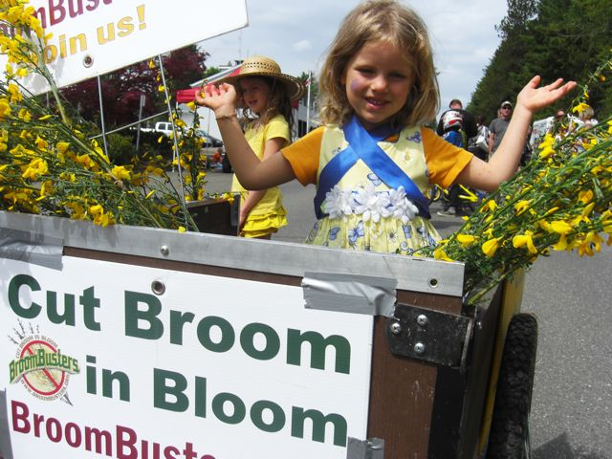
Why do we cut broom? For Future Generations.
www.Broombusters.org We can help!

Slide 47
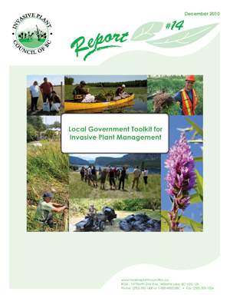
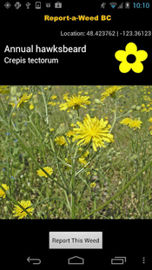
Tools for moving forward
Efficient Collaborative Management
Coastal Invasive Species Committee
Broombusters
ISCBC: Local Government Toolkit and resource site for IPM
Best Management Practices/Fact Sheets
Report-A-Weed BC (app)
SAVE THE DATE: June 8th, Coastal ISC Spring Forum; at Qualicum Beach Civic Center

Slide 48
Summary and Conclusion
Weeds know no boundaries (management cannot be resolved in isolation)
Impacts are diverse (biodiversity, health, infrastructure, agriculture)
Costs will continue to increase over time; opportunities to control decrease over time. (EDRR)
Pooling of existing resources and coordination improves overall management and capacity
Need to be strategic – can’t do it all!

Slide 49
Thank You!
Rachelle McElroy
Toll Free: 1-844-298-2532
Email: info@coastalisc.com
www.coastalisc.com
Joanne Sales
Phone: 250-752-4816
Email: info@broombusters.org
www.Broombusters.org

